Slide 1
A Crash Course
in Linear Algebra
01/12/2016
이한아

Slide 2
Contents
Linear systems
Gauss-Jordan Elimination
Matrices
Finding Inverse
Vector, Vector spaces
Least Squares
Matrix Decomposition
Eigenvalues and Eigenvectors

Slide 3
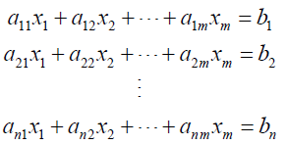
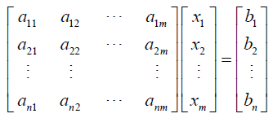
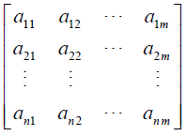
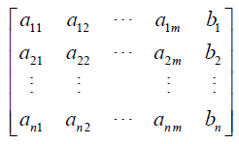
Linear Systems
a linear equation
a system of linear equations
n equations
m unknowns
solutuion? (1) no solution, (2) exactly one solution, (3) infinitely many solutions
coefficent matrix
augmented matrix
Gauss-Jordan Elimination (to a RREF)
Elementary row operations: (1) Replacement, (2) Interchange, (3) Scaling
Gauss Elimination (to a REF)
Back substituion

Slide 4

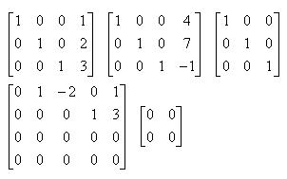
Row Echelon Form (REF)
Reduced Row Echelon Form (RREF)
All nonzero rows are above any rows of all zeros.
Each leading entry of a row is in a column to the right of the leading entry of the row above it.
All entries in a column below a leading entry are zeros.
The leading entry in each nonzero row is 1.
Each leading 1 is the only nonzero entry in its column.

Slide 5
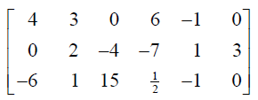
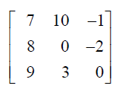
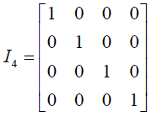
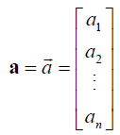
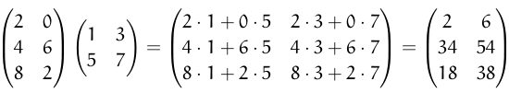
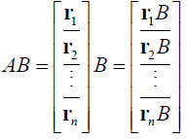
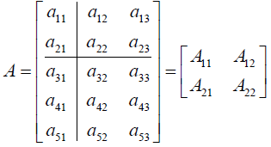

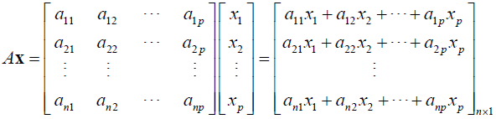
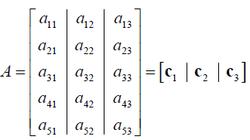
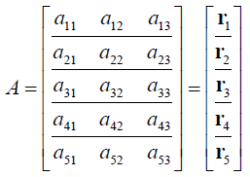
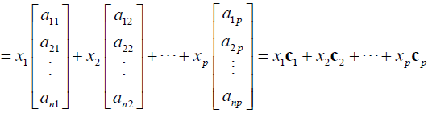
Matrices
matrix addition/subtraction
scalar multiplication/matrix muliplication
transpose
trace: sum of main diagonal
invertible, determinant, inverse, (non)singular
triangular matrix, symmetric matrix
entry
size
square matrix
main diagonal
identity matrix
column vector
row vector
submatrices

Slide 6

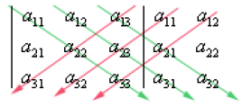
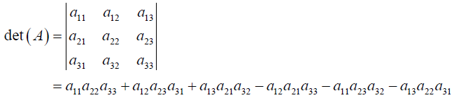





Finding Inverse
nxn square matrix
inverse of a 2x2 matrix
determinant
using cofactors
using row reduction
determinant properties
det(AB)=(detA)(detB)
(detA^{T})=detA
If A is triangular, then detA=product of main diagonals
A row replacement operation does NOT change the determinant
A row scaling scales the determinant by the same scalar factor
matrix inversion
using elementary matrices

Slide 7
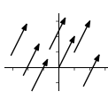




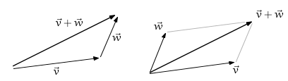



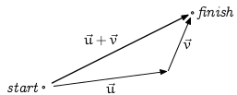


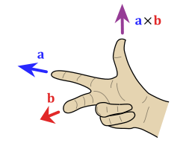

Vector
vector: consisting of a magnitude and a direction
vector sum
scalar multiplication
length (norm)
dot product (=inner product): a scalar
triangle inequality
Cauchy-Schwarz inequality
angle between two vectors
orthogonal/ orthonormal
cross product: only defined in R³

Slide 8
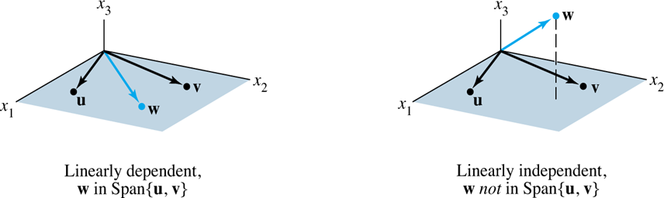
Vector spaces
conditions
contains zero vector
closed under vector addition
closed under scalar multiplication
null space
nullity
row space: Span{r₁, r₂, … r_{m}}
span: linear combination of vectors
basis: linearly independent set of vectors
column space: Span{c₁, c₂, … c_{n}}
rank-nullity theorem
N(A) + R(A) = Dim(A)

Slide 9
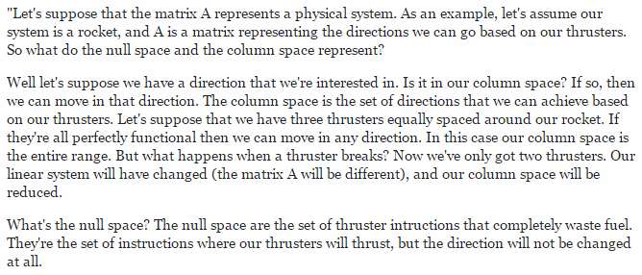
Null space
http://math.stackexchange.com/questions/21131/physical-meaning-of-null-space-of-a-matrix

